Slide 1
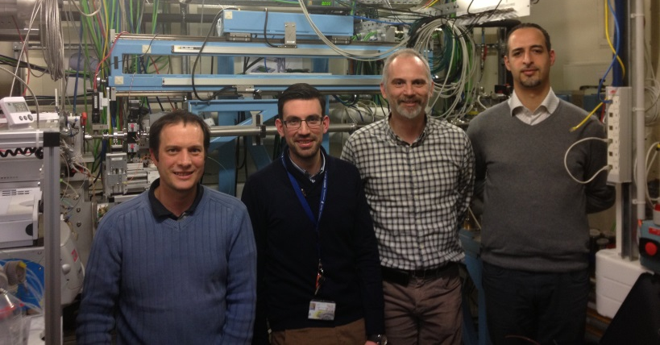
Biology at SWING beamline
SAXS - WAXS - GISAXS
SWING
A. Thureau, T. Bizien, J. Pérez, Y. Liatimi
Synchrotron Soleil, Gif-sur-Yvette, France

Slide 2
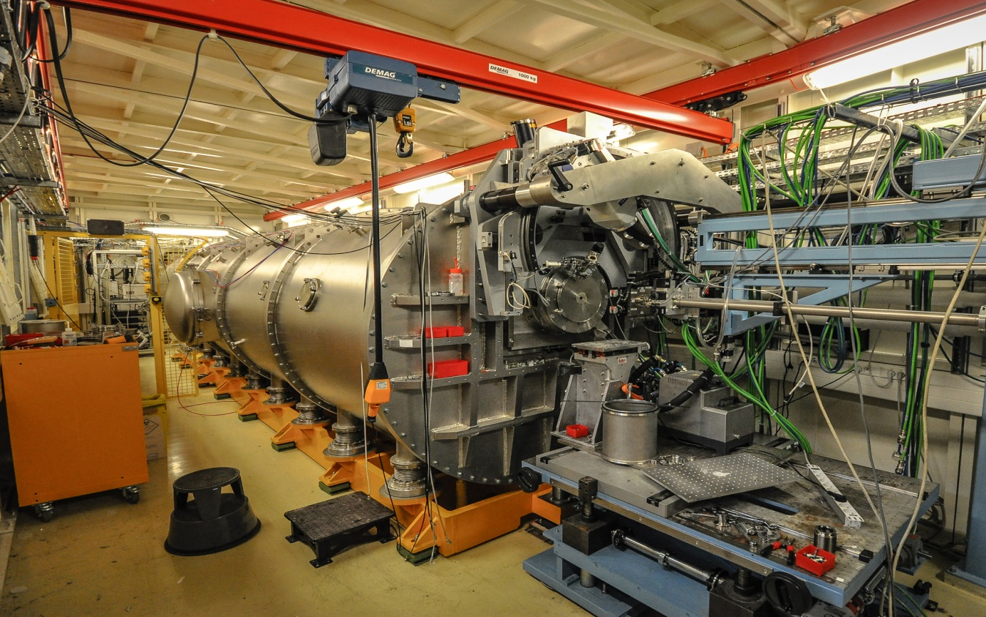
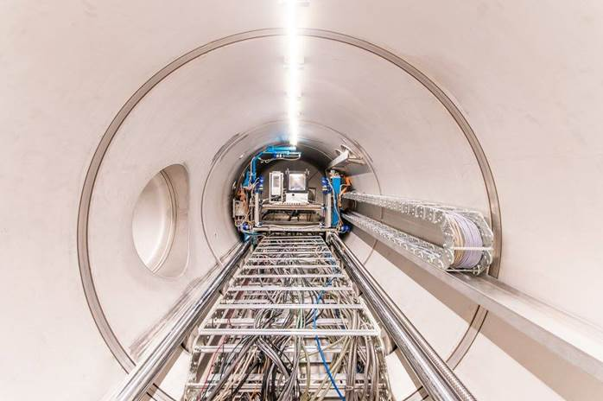
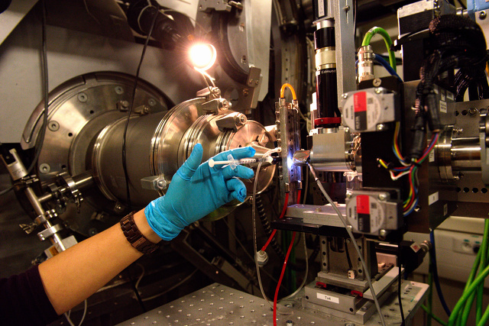
Full flux = 5.10¹² ph/s @ 12 keV
Beam size (FWHM) =
400 (H) x 25-100 (V) µm²
Structural Biology (macromolecular shapes / low resolution structure)
Soft Condensed Matter (crystal growth, colloids, polymers, liquid crystals, hierarchical systems, …)
X-Ray Beam
In vacuum detector
(from 500 to 6700 mm sample to detector distance)
Users environment

Slide 3
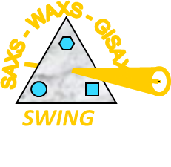
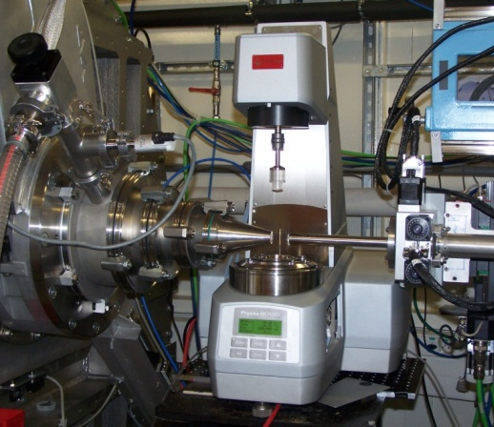
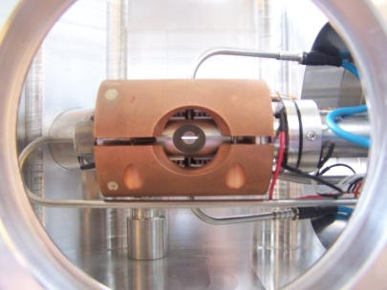
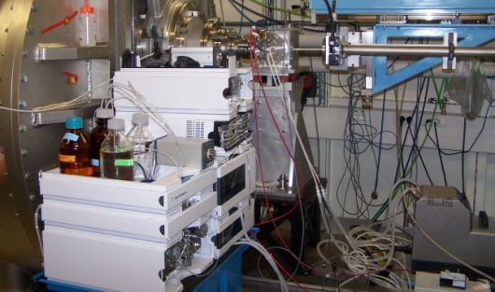
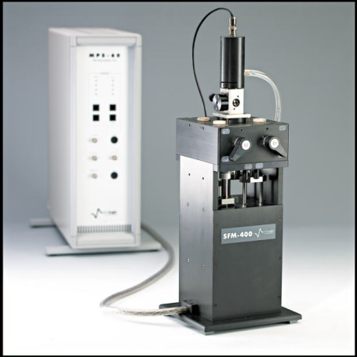
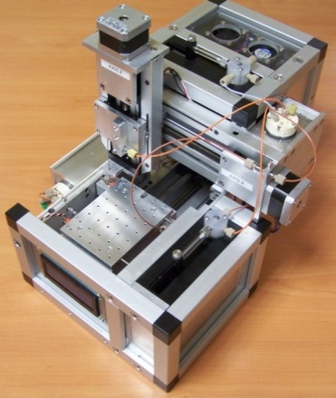
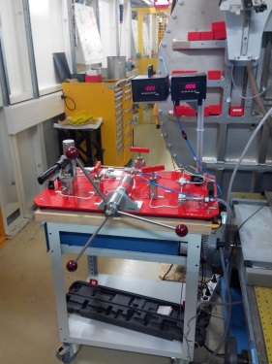
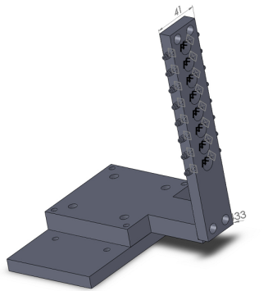
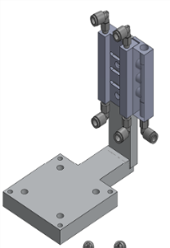
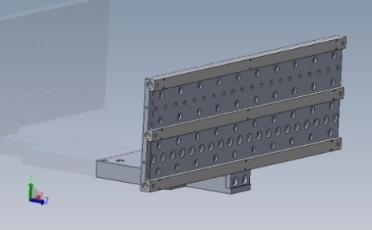
Many available sample environments
Thermostated Anton Paar Rheometer (collab. LPS, Orsay, France)
Biologic SFM400 Stopped-Flow for chemistry/biology (courtesy Biology Lab)
Linkam Hot stage for capillaries (T < 600°C)
Circulation cell for proteins in solution, with Peltier T° control & UV-Vis Abs
On-line HPLC coupled with preparator and injector for protein solution samples
Automated High Pressure Cell for liquid samples (P < 5 kBar)
Automated Injection Robot for liquid samples
*Interchangeable* sample holders:
Motorized (3 axis), Thermalized (10 – 70°C)
Flow-through thin (10µm) quartz capillaries
For gels
For sealed capillaries

Slide 4
What I'm going to talk about
SEC-SAXS
UV-SAXS+UV-MALLS-RI installed permanently
IspyB
AutoBioSAXS is working and connected to IspyB
Confidentiality of BAGs

Slide 5
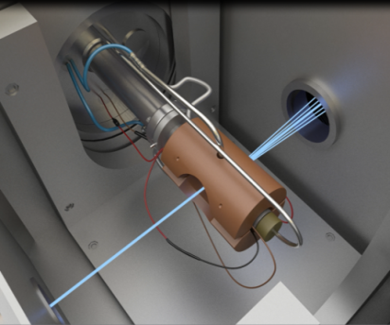
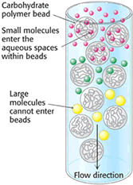
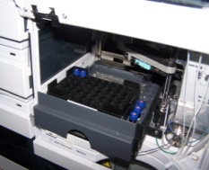
Bio-SAXS schematics
SAXS
MALLS detector
(18 angles+QELS)
Samples for BATCH-SAXS: 10µl (1 mg/ml) to 50 µl for (0.1 mg/ml)
RI detector
Automated process for injection and detection:
Automated injection for both Batch and SEC-SAXS
Users just need to set up : Sample name, Rack Position, Volume and Column circuit
Multiple injections for both Batch and SEC-SAXS can be set-up
Automated analysis process: AutoBioSaxs + IspyB
Saxs Curves => In-House & Atsas pipeline
Samples for SEC-SAXS: 10µl (20mg/ml) to 80 µl for (1,0mg/ml)
UV detector
(8 wavelengths)

Slide 6
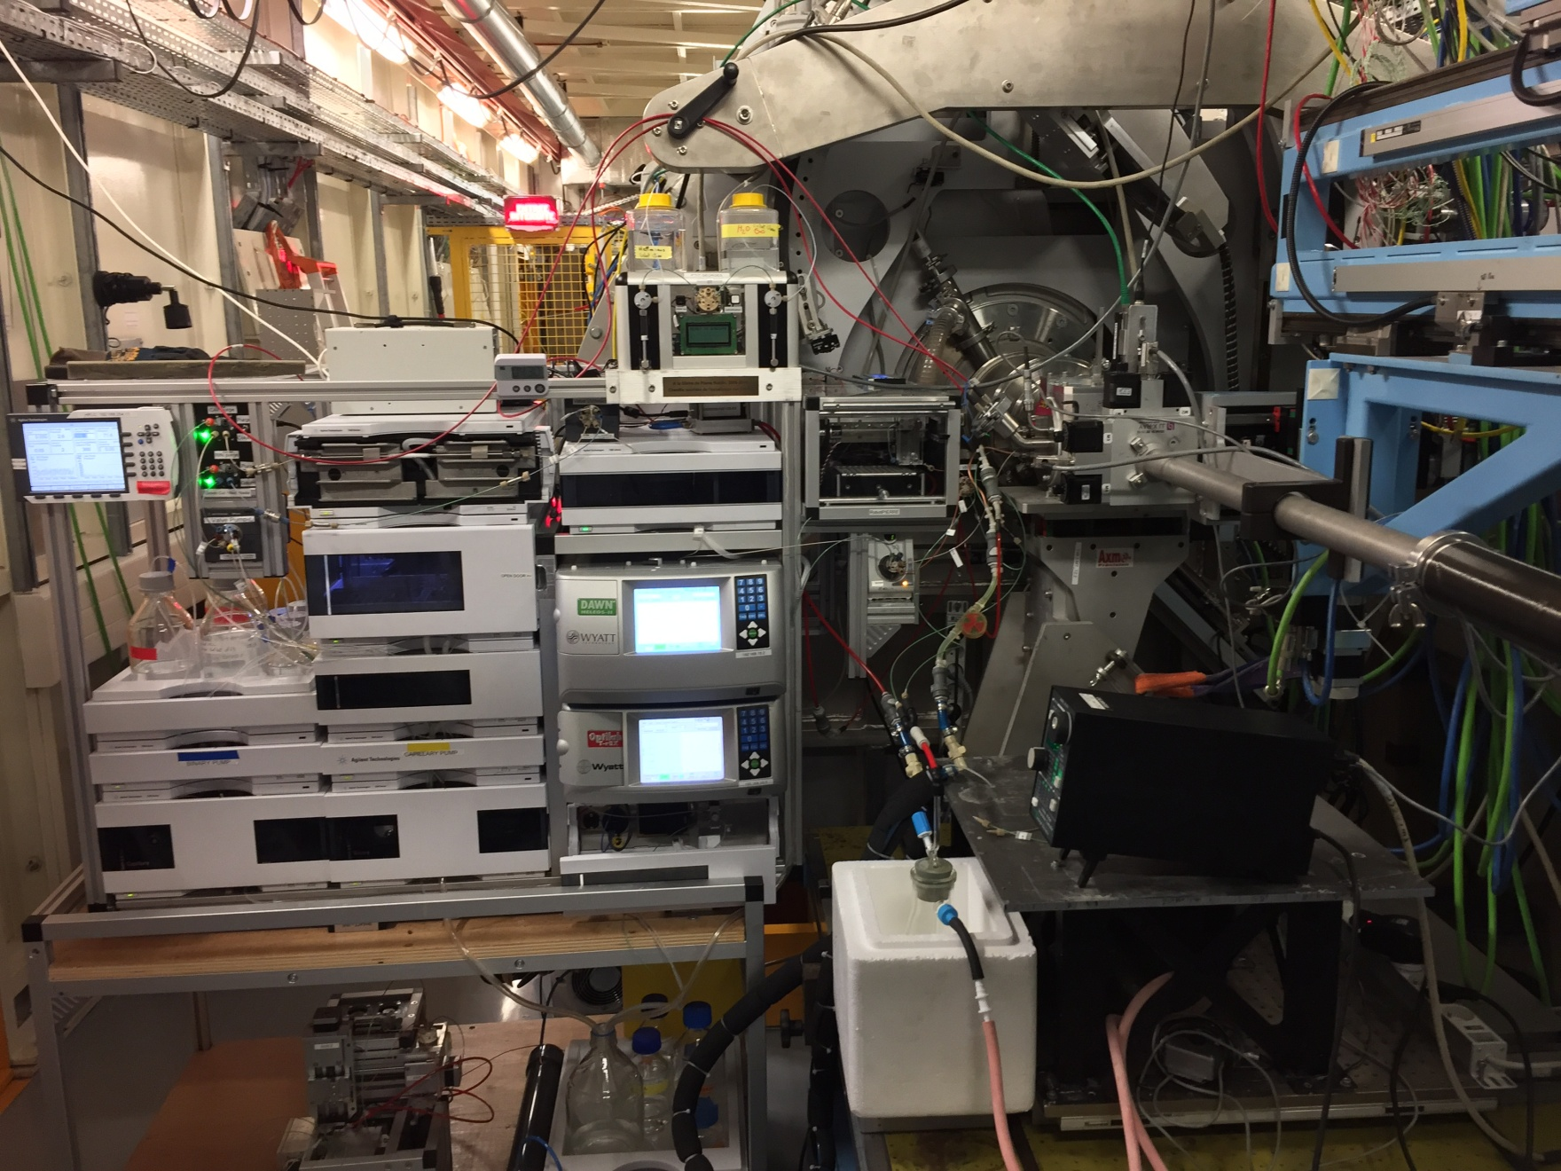
HPLC – MALLS/QELS – SAXS – RI online
Capillary cleaning automated set-up
Wyatt 18-angles MALLS/DLS
Agilent UV
SAXS + UV
New Batch Mode Injector
Switches for easy circuit purge
Wyatt Refractometer
Old Batch Mode Injector
=> MALS & RI : new possible informations for IspyB

Slide 7
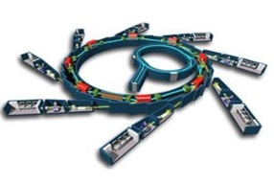
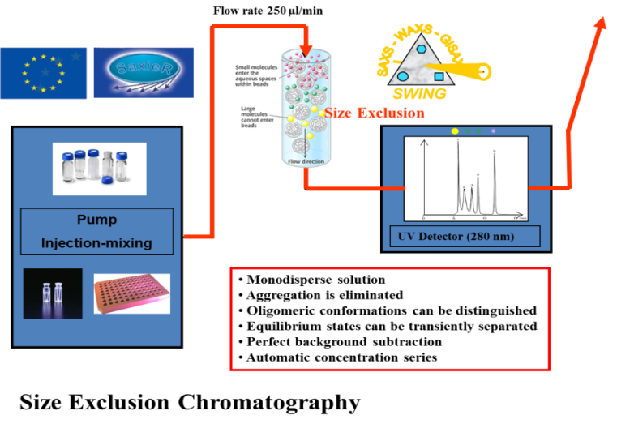
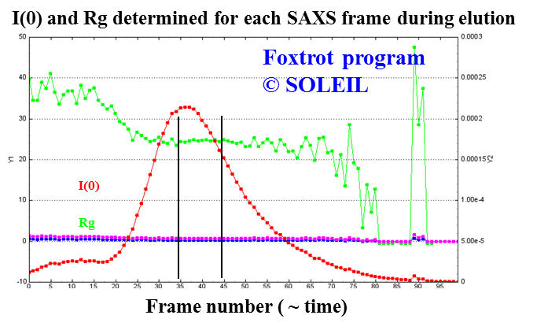
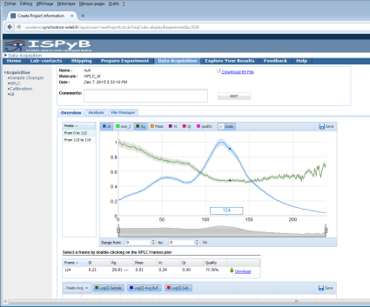
AutoBioSAXS : Automatic Data Treatment workflow for BioSaxs
SAXS coupled with Size Exclusion HPLC
Detected : I(Q)
I₀, l
2θ
Radial average
+
buffer subtraction
(Foxtrot libraries)
2D detector
Ln ( I )
Q=4π sinθ/λ
(ATSAS suite of programs)
(IspyB Web Application)
(IspyB Web Application)

Slide 8
Implementation of confidentiality of BAGs on SWING Beamline
Pre-Experiment
Sunset
Experiment
Swing
Sample X
Sample Z
BAG
<project ID>
Sample Y
PI Member A <member ID>
PI Member B <member ID>
PI Member C <member ID>
IspyB
Session 1 <session ID>
Session 2 <session ID>
Session 3 <session ID>
User 1 => <project ID> / <Member ID> / <Session ID>
User 2 => <project ID> / <Member ID> / <Session ID>
<project ID> / <Member ID> / <Session ID>
Sunset
User 3 => <project ID> / <Member ID> / <Session ID>
<project ID> / <Member ID> / <Session ID>
<project ID> / <Member ID> / <Session ID>
User 1
User 2
User 3
Post-Experiment

Slide 9
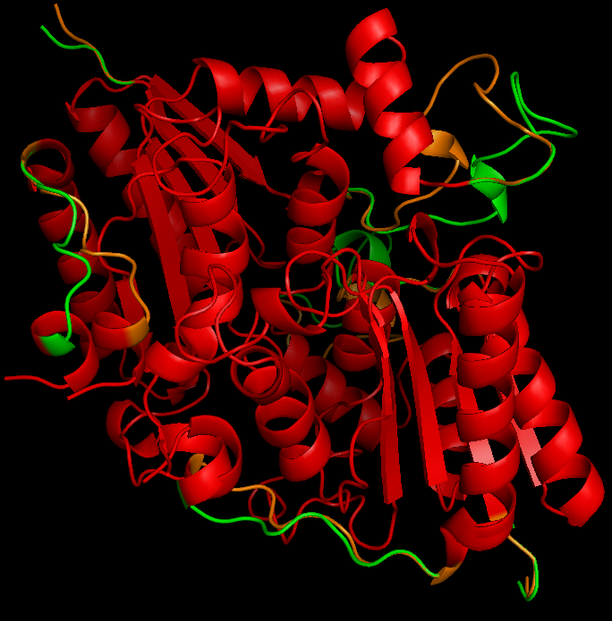
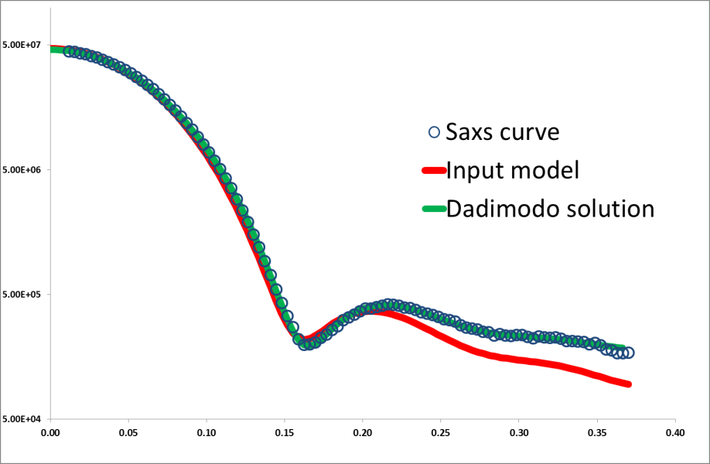
Dadimodo: refining domain orientations with an all-atom description
experimental
Dadimodo
Initial (slow) version : Evrard et al. (2011), J. Appl. Cryst., 44:1264-1271.
Parallel implementation of the genetic algorithm
7300 Atoms → 7 hours on a 20 processor node
User-friendly input
User-defined topology : Pdb file + rigid bodies definitions
Automated completion (when needed) of pdb input files
This year
Server dedicated to external users
O. Roudenko , A. Thureau, J. Pérez
=> Why not also on IspyB ?

Slide 10
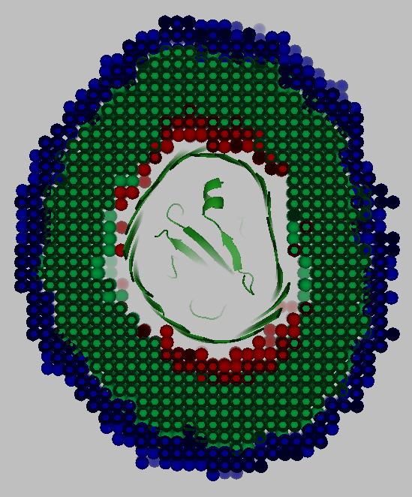
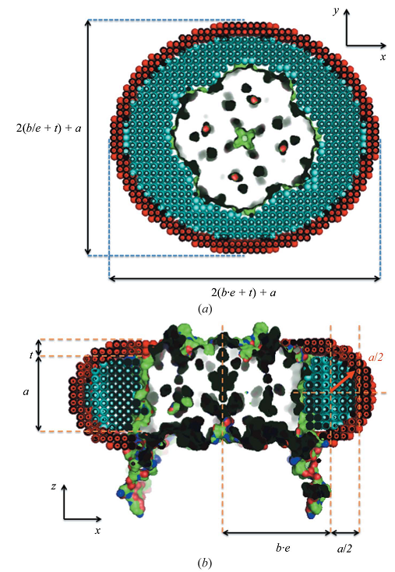
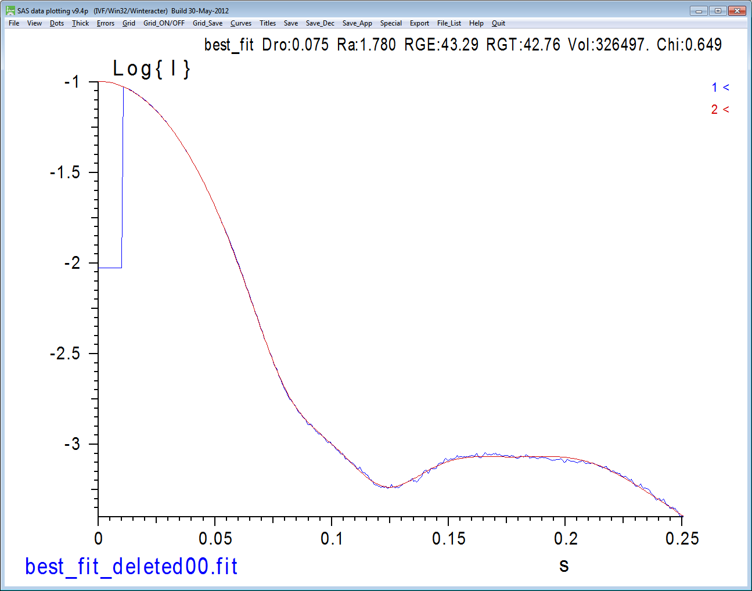
MEMPROT : Correlations between parameters in the corona geometrical model
DeltaHasR-HasA shape
Pérez J. & Koutsioubas, A. Acta Cryst. (2014)
=> Why not also on IspyB ?

Slide 11
HasR-HasA, now including the signal domain
Dadimodo → specially adapted for coarse grain corona
Wojtowicz et al., Biochem. J. (2016) 473, 2239–2248
Average position in presence of HasA
Average position in the absence of HasA
The interaction of HasA with HasR seems to bring the signaling domain closer to the membrane
=> Why not also on IspyB ?

Slide 12
To resume, on Swing Beamline:
Just some ideas to add more data on IspyB
Saxs Measurement
Mals, RI & fluoresence profils curves
Membrane proteins (EMBL-HH)
Atomic models
AutoBioSaxs
IspyB Test Database
EXI development to be done by Soleil
Modification of IHM
Including ESRF request
Reprocessing
…
IspyB Database
In few weeks
EXI (direct access)
IspyB via Sunset
EXI via Sunset
Users
Simple Project & BAGs (confidentiality)
Soleil Staff

Slide 13
Contributors
AutoBioSAXS – Foxtrot - IspyB
Majid Ounsy (ICA)
Grégory Viguier (ICA)
Idrissou Chado (ISG)
Raphaël Girardot (ICA)
Frantz Pili (ICA)
Alejandro Diaz (ISI)
HPLC-MALLS
Mattia Rocco
Memprot
Alexandros Koutsioumpas
Maciej Baranowski
New BioSaxs cell
Cedric Dicko (Lund University)
Tomás Plivelic (Max IV)
Jean-Michel Dubuisson (BE)
Matthieu Lecroard (BE)
Dadimodo on the Web
Olga Roudenko (ICL)
Nicolas Labrude (ISG)

